Slide 1


Independence Day

Slide 2


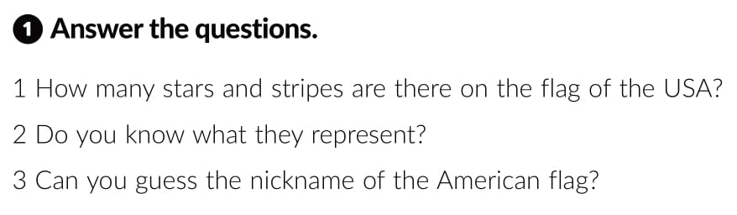


Slide 3
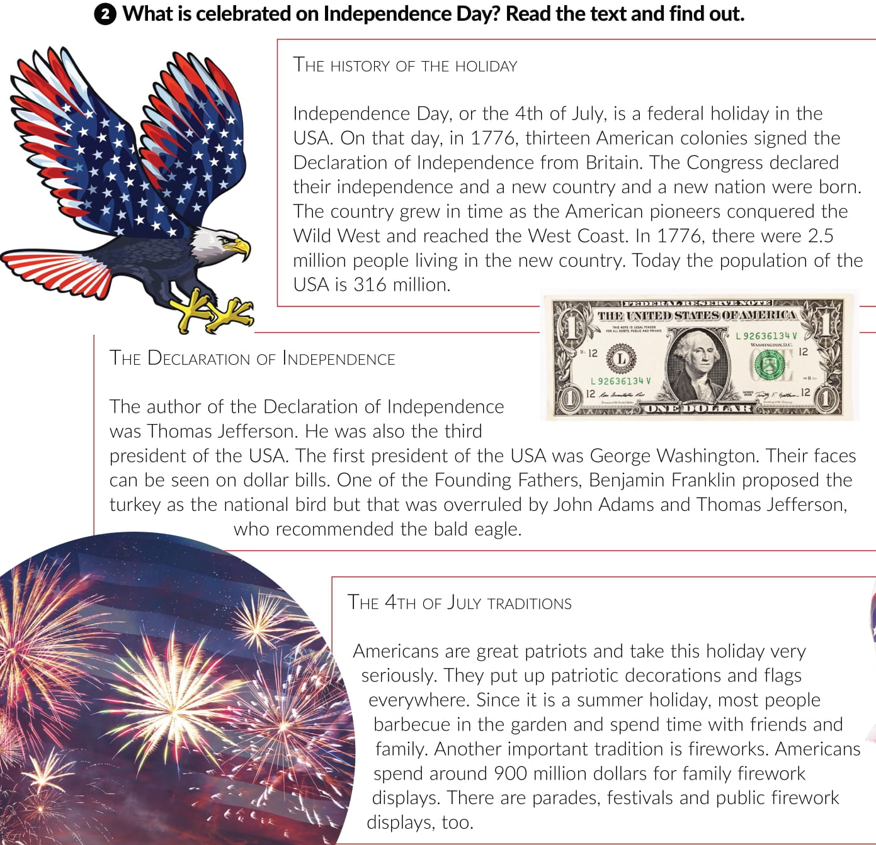

Slide 4
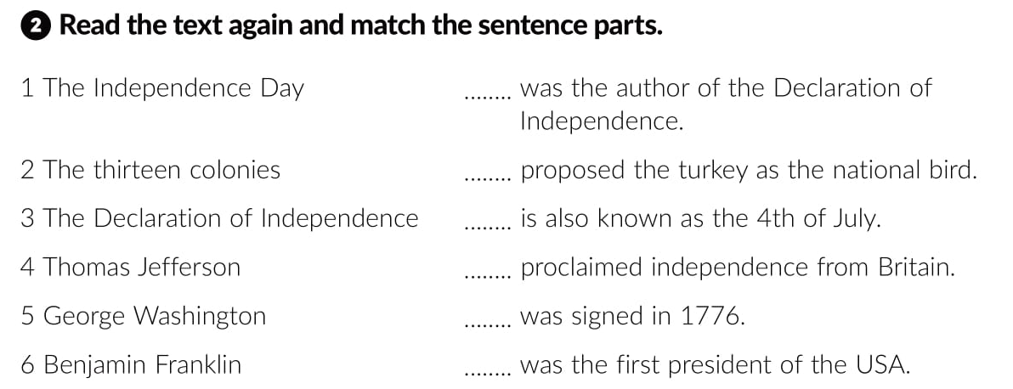
4
6
1
2
3
5

Slide 5
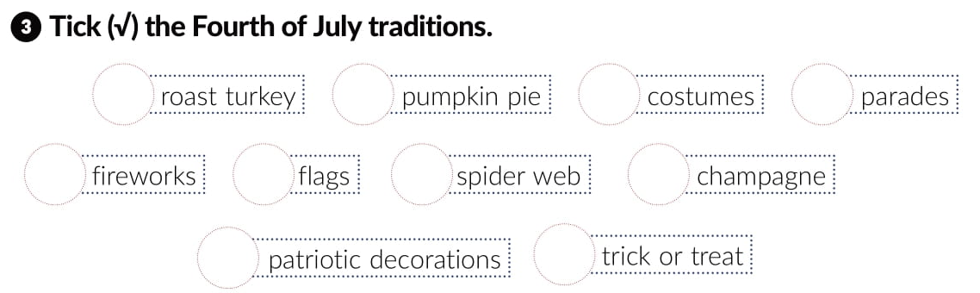


Slide 6
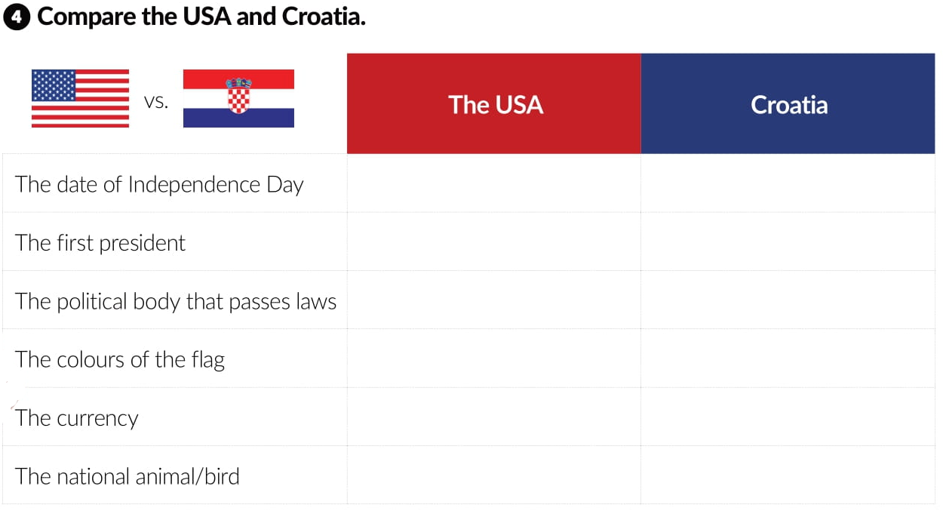
4th July
25th June
George Washington
Franjo Tuđman
Congress
Sabor
red, blue and white
red, blue and white
US dollar
euro
bald eagle / bison
kuna

Slide 7
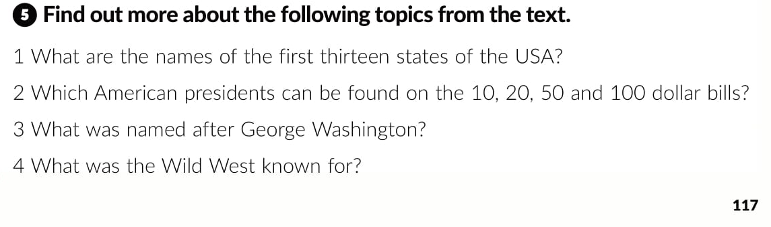

Slide 8

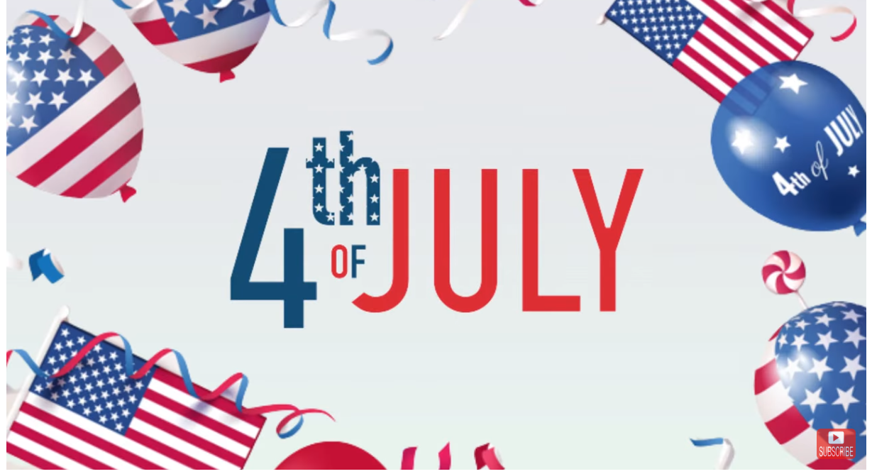
Otvori sljedeću poveznicu i pogledaj video
https://www.youtube.com/watch?v=fFnItnVlWws&ab_channel=LearnEnglishbyPocketPassport

